Slide 1
Project Name
Technical Bio- Management System

Slide 2
Team Details
Team Name: Rising Star Web
TEAM LEADER : Abisha.Y
Team Members: 1. Gilda Jeni
2. Karthiga
3. Kohila
4.Bala Sree Kumary
Notes:
-Add team details with name and qualification,e-mail,phone no and place

Slide 3
Introduction
This is going to be a Web application for managing the student bio data. It also helps the student of the college or any other institution to manage his or her biodata. By using the application the student can manage his general details, education details, profile, objective, professional experience, technical expertise and project details, Personal Details. Various Features of this project are
The student can take the print out of the resume whenever required
The Student can edit the biodata details whenever he obtained new qualification or any other updates done in the profile
He can manage his biodata on the server and he did not need to keep it as a hardcopy

Slide 4
Database Design
User Details
Design
Basic Details
SQL
BIODATA
Personal Details
Educational Details
Technology details
Experience Details
Notes:
Get the database design from the phpmyadmin or from SRS document

Slide 5
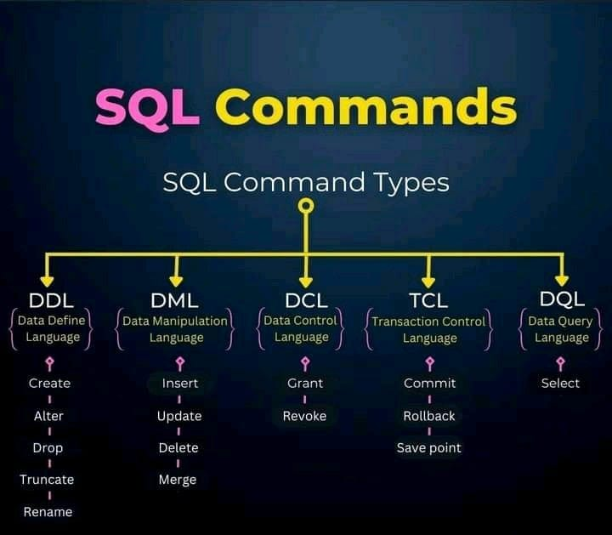
SQL

Slide 6
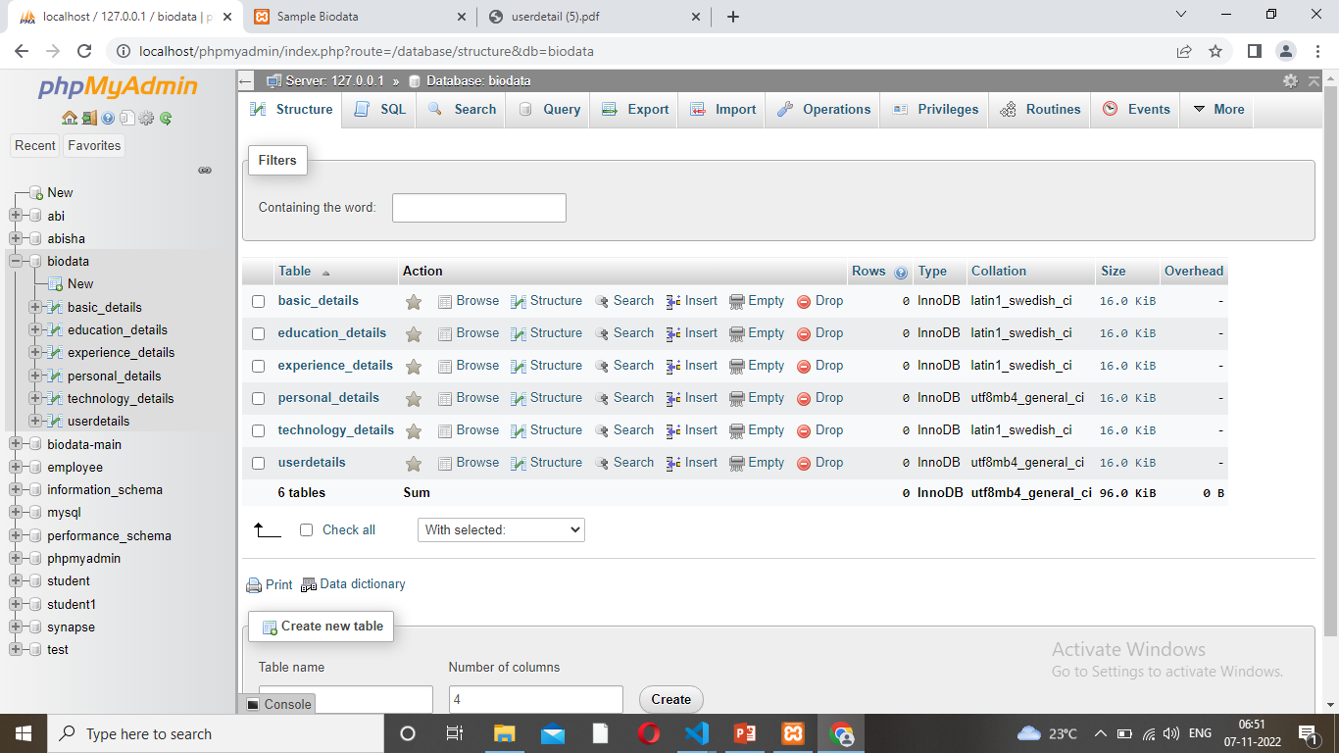
Database Design

Slide 7
Form Design
FORM
SQL BIODATA
LOGIN SCREENS |  |  | OTHER PAGES
USER DETAILS | BASIC DETAILS | EDUCATIONAL DETAILS | EXPERIENCE DETAILS | TECHNICAL ETAILS | PERSONAL DETAILS

Slide 8
TEAM MEMBER -1 Gilda Jeni and Bala Sree

Slide 9
Database Design – Educational Details
SQL
BIODATA
ID
Educational Details
Percentage
User code
Pass Year
Course Name
College
University
Notes:
Explain Form and database worked with

Slide 10
Forms Design – Educational Details
SQL – BIODATA- EDUCATIONAL DETAILS
ID | User code | Course Name | University | College | Pass Year | Percentage
#001 | 001 | JENI | ANNA | LJCET | 2021 | 85%

Slide 11
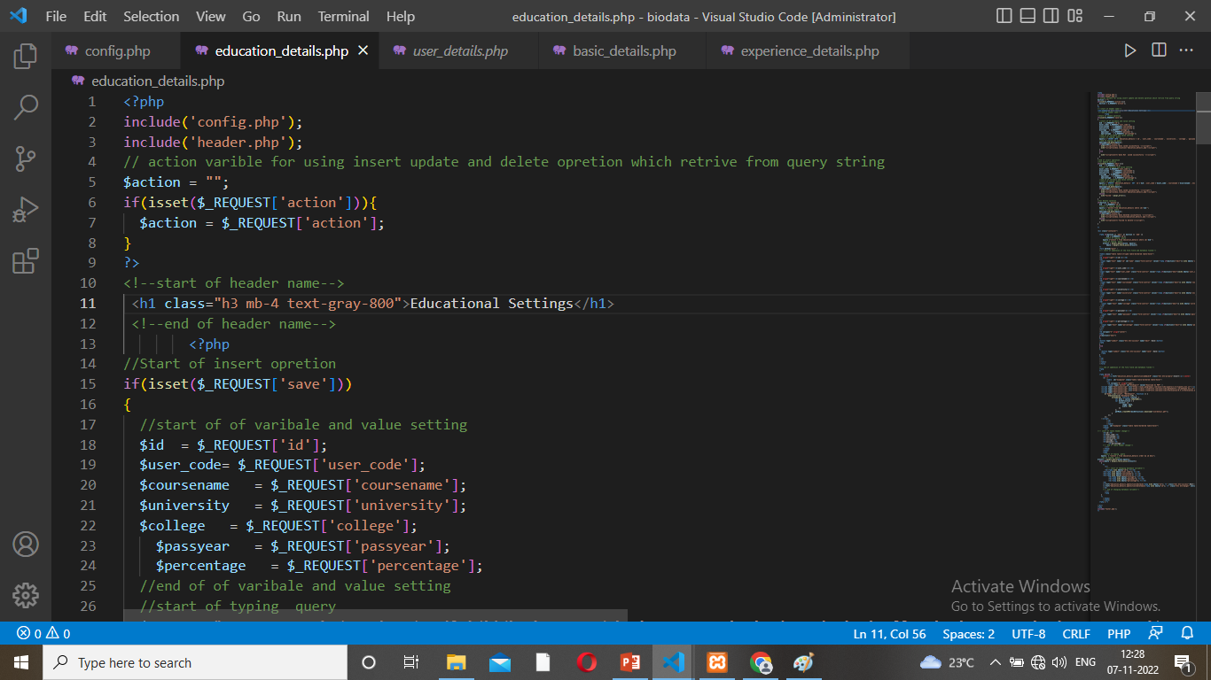
SOURCE CODE – EDUCATIONAL DETAILS

Slide 12
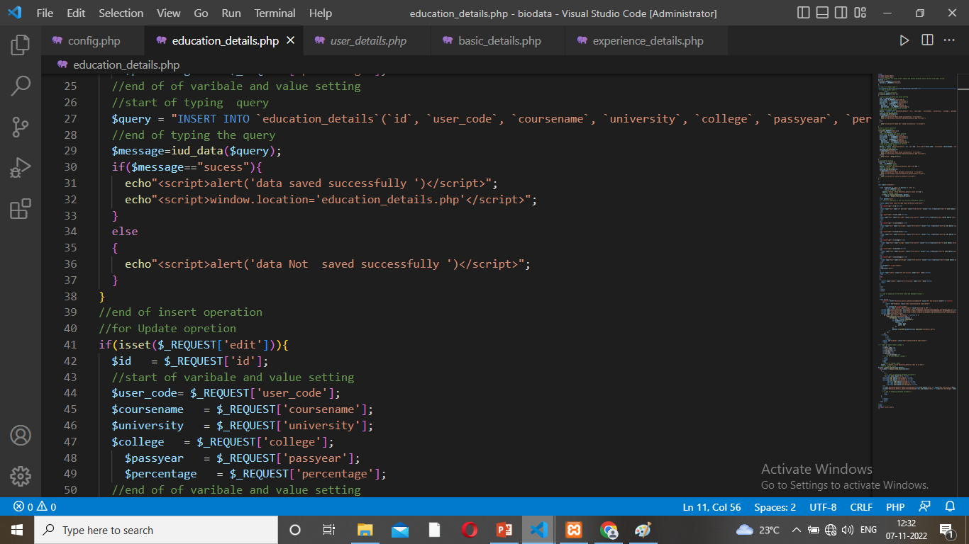
Source Code – Educational Details

Slide 13
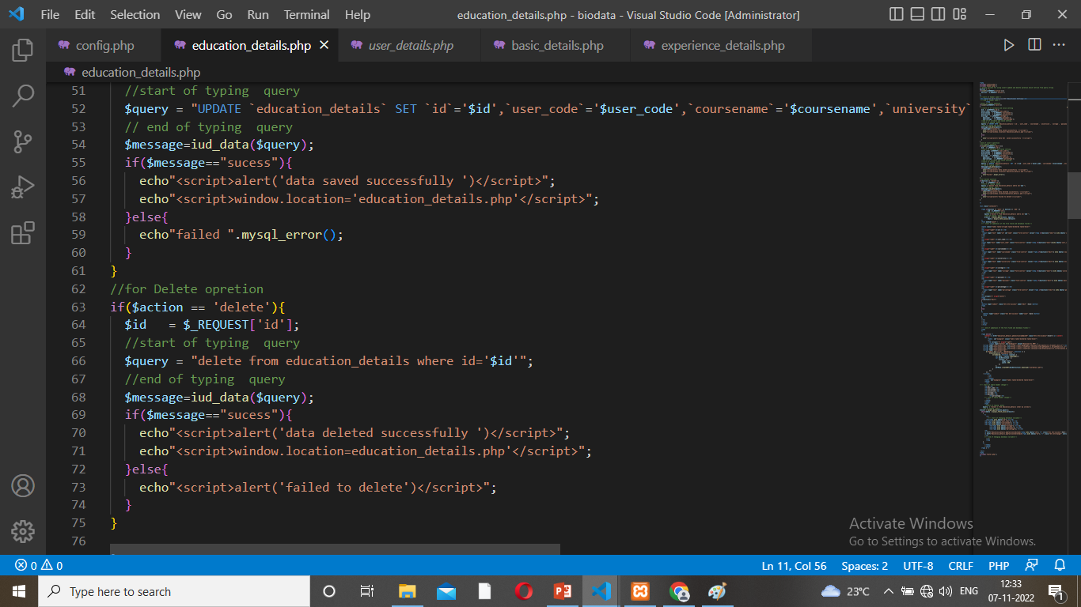
Source Code – Educational Details

Slide 14
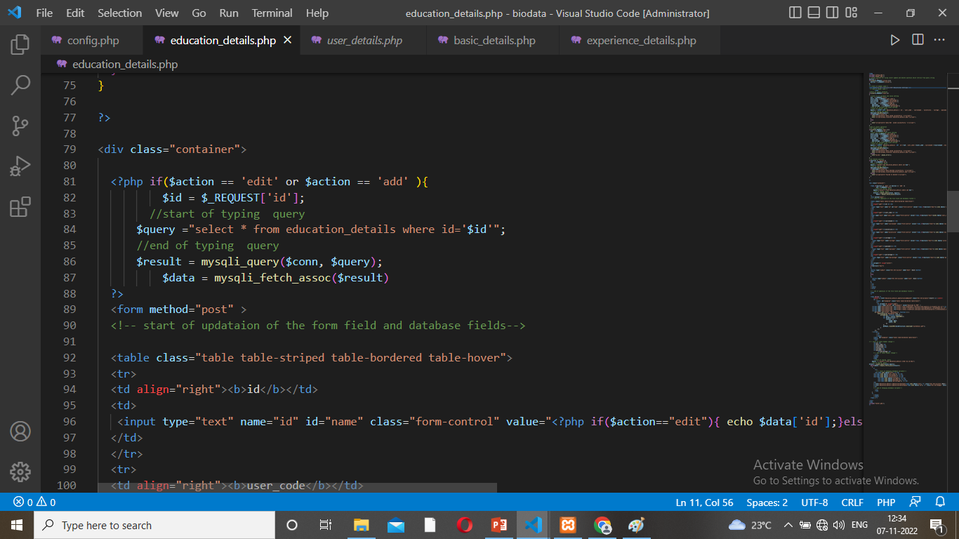
Source Code – Educational Details

Slide 15
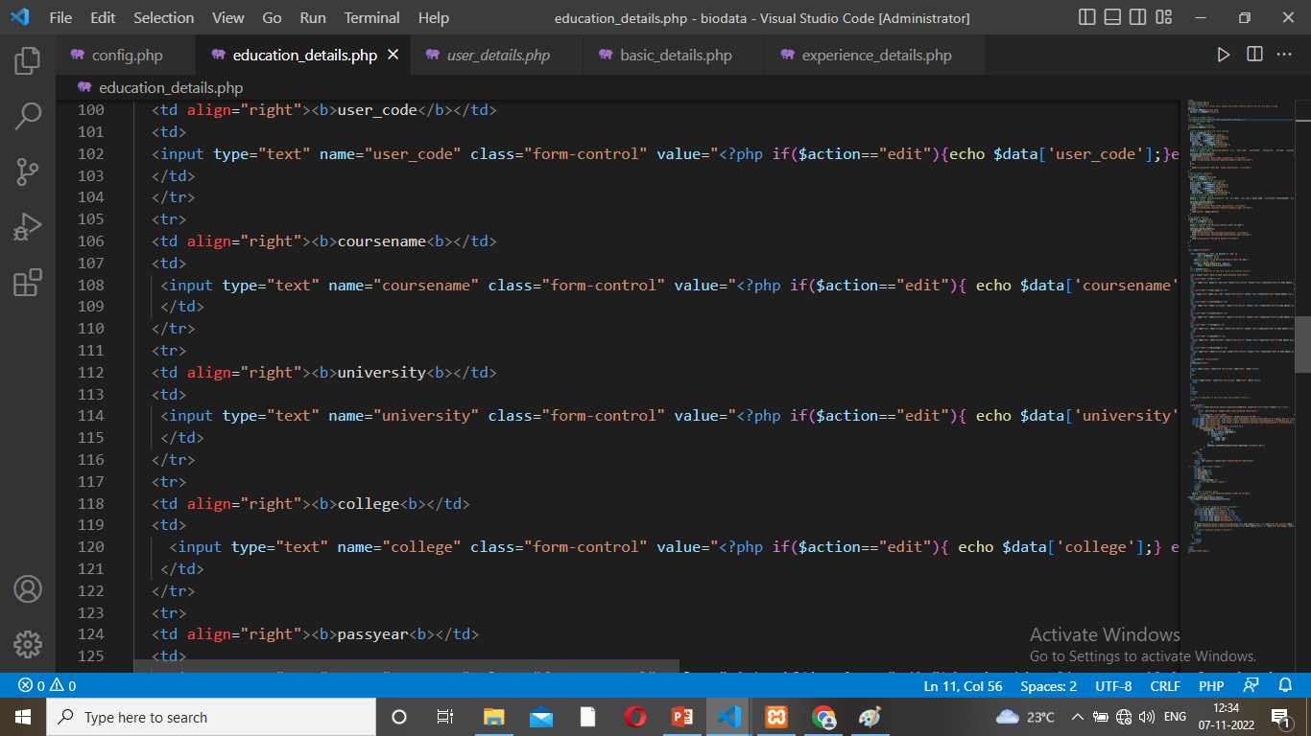
Source Code – Educational Details

Slide 16

Source Code – Educational Details

Slide 17
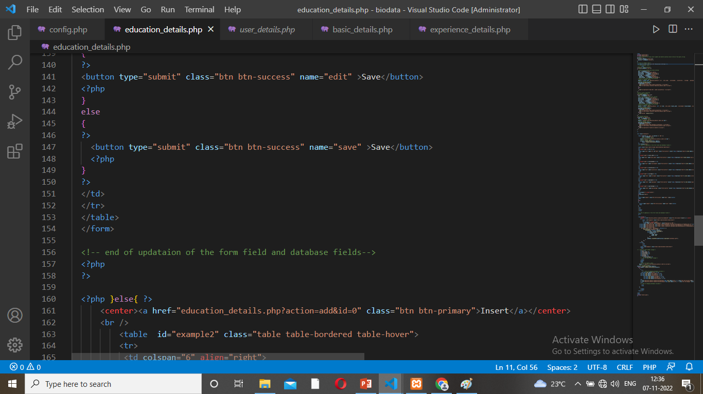
Source Code – Educational Details

Slide 18
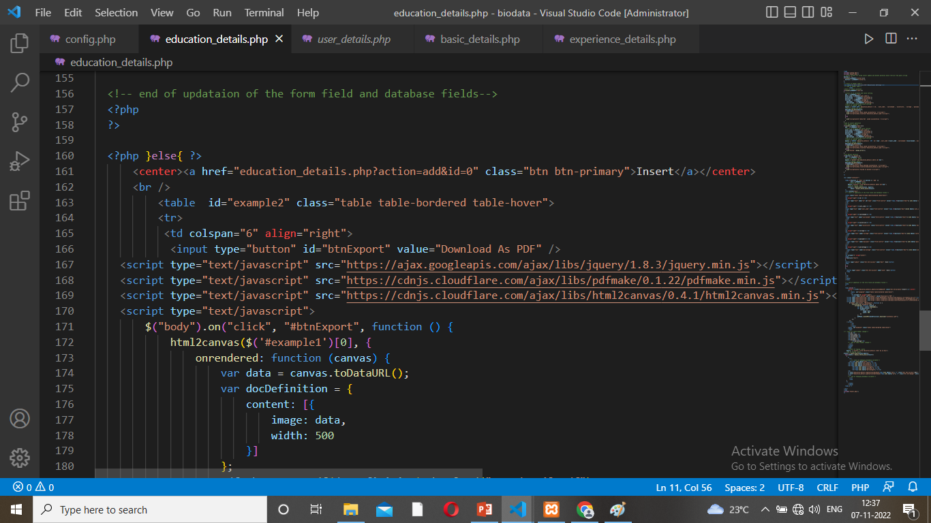
Source Code – Educational Details

Slide 19
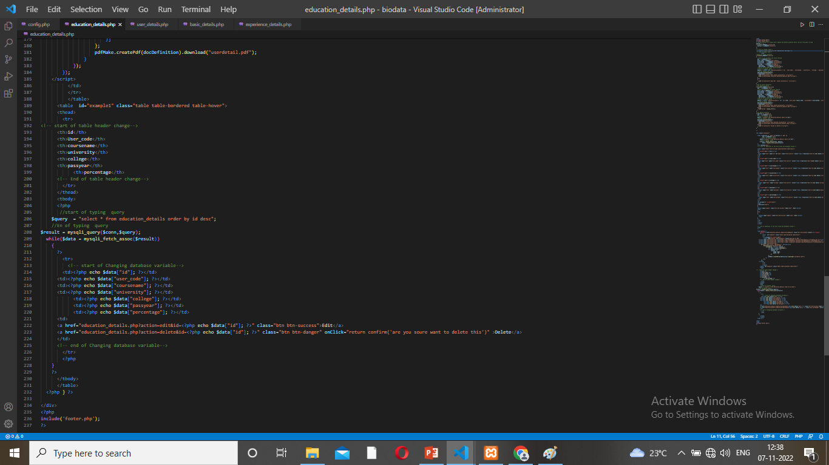
Source Code – Educational Details

Slide 20
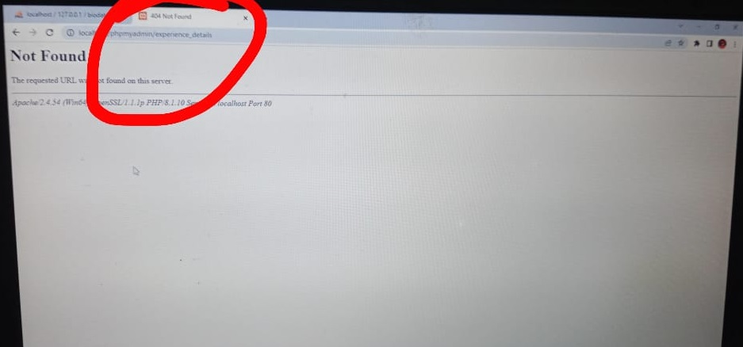
Problem/difficulty Faced
Link Path Change so not found on display screen
Notes:
Explain problem faced

Slide 21
Solution to the problem
I sent to this photo my team leader.
She is told path change.
So I correct the folder and database name.
Next I can visual the display.
Notes:
Explain how attained the solution

Slide 22
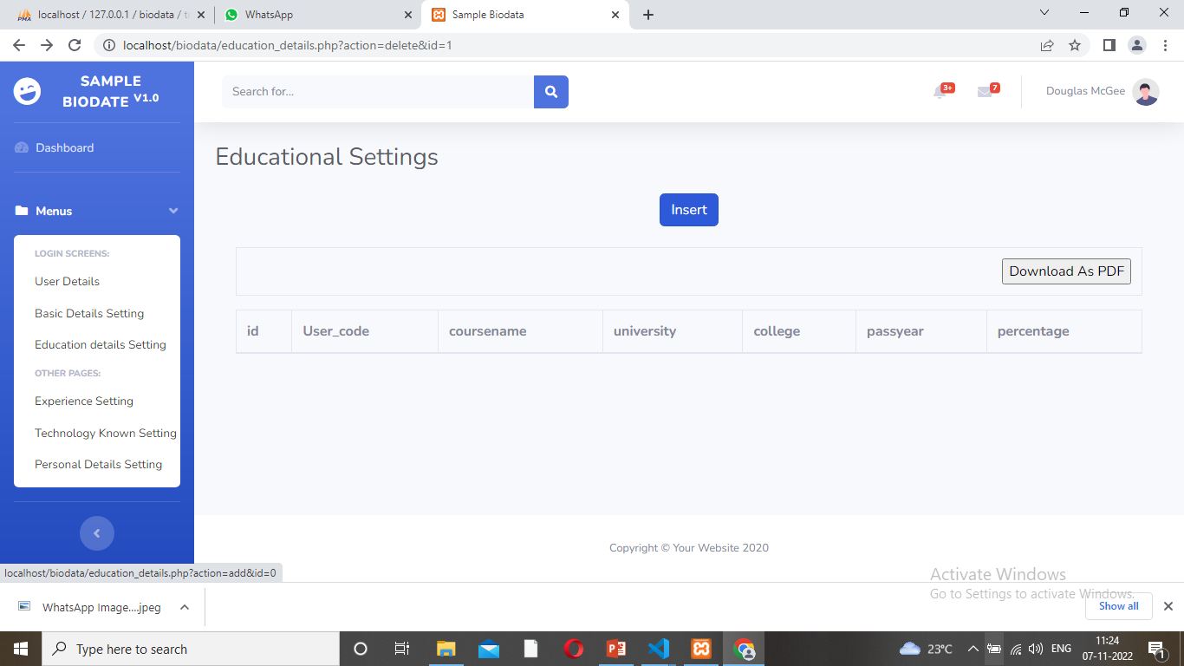
Form Design
Design View to click insert button

Slide 23
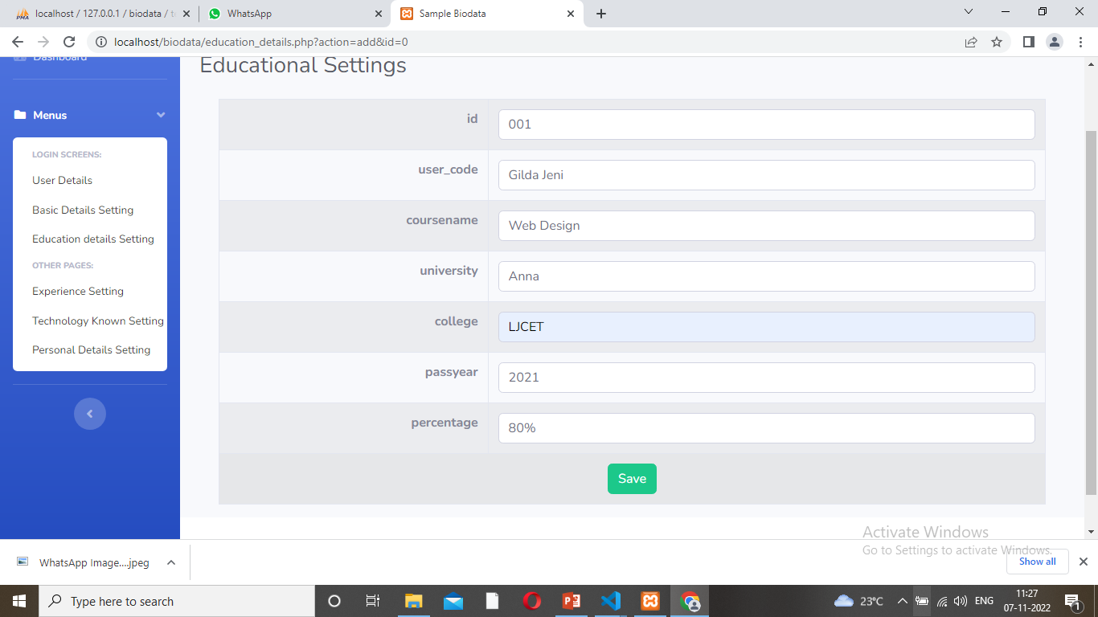
Form Design
Type the data - save

Slide 24
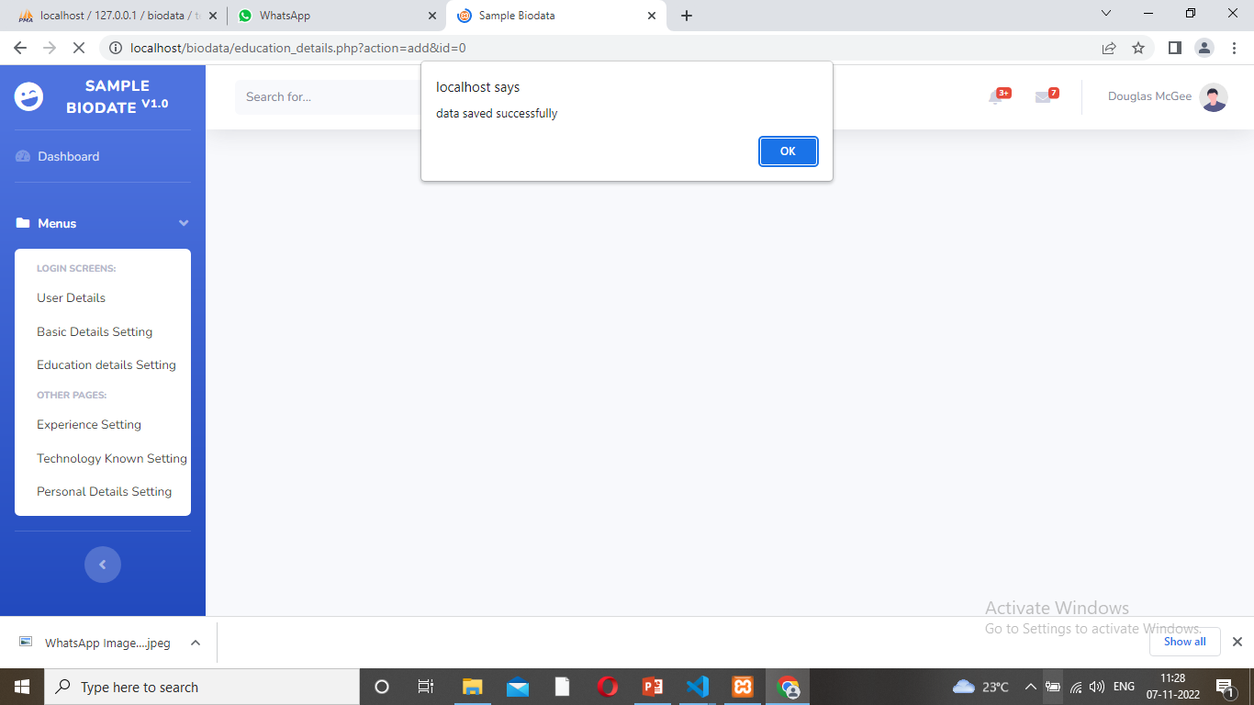
Form Design
Click save to one message box

Slide 25
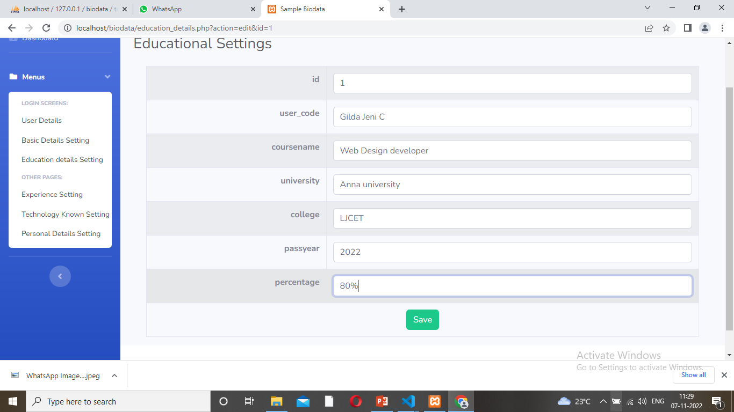
Form Design
Click Edit Box – Display the form

Slide 26

Form Design
Click save- data saved successfully messege box.

Slide 27
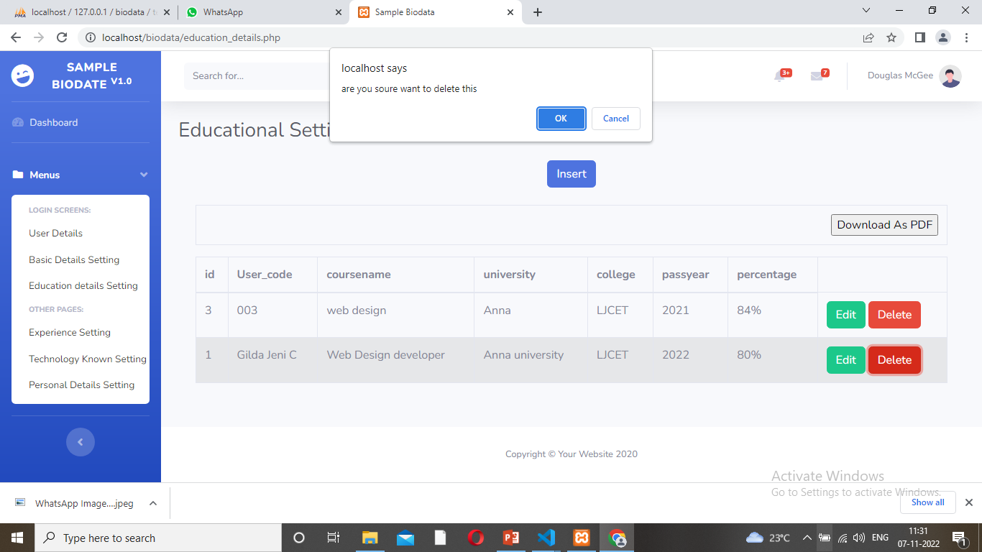
Form Design
Click Delete Button – so ask messege are you ant to delete this- click ok

Slide 28
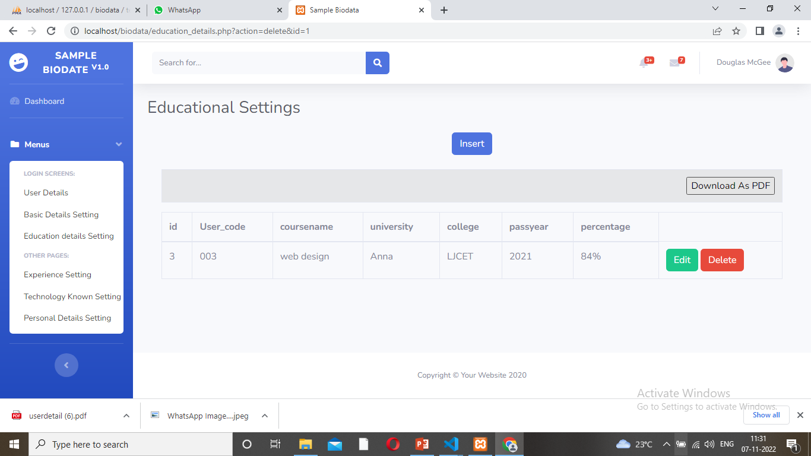
Form Design
Select Down load pf click

Slide 29
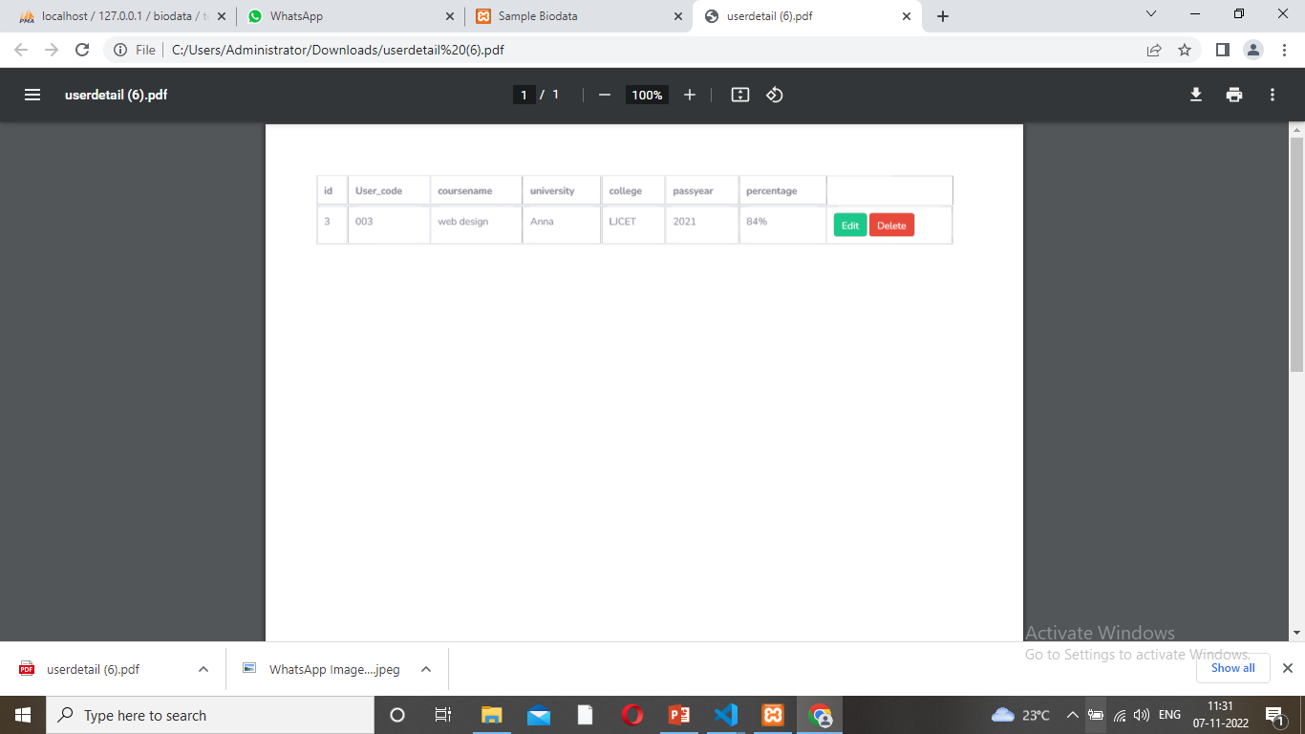
Form Design
Print the pdf

Slide 30
TEAM MEMBER -2 Karthiga and Kohila

Slide 31
Database Design – User Details
SQL
BIODATA
Mobile
ID
User Details
User Name
Email
Name

Slide 32
Form Design – User Details
SQL BIODATA
ID | NAME | USER NAME | EMAIL | MOBILE
001 | Karthiga | Karthiga | karthi@gmail.com | 9678906542

Slide 33
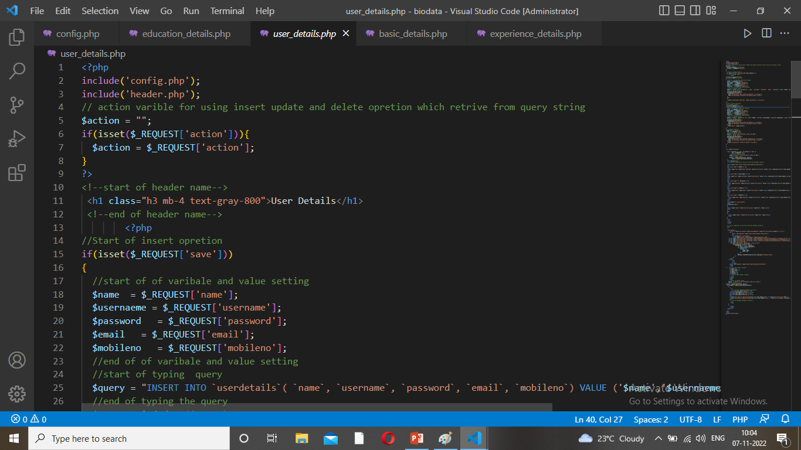
Sample Source code

Slide 34
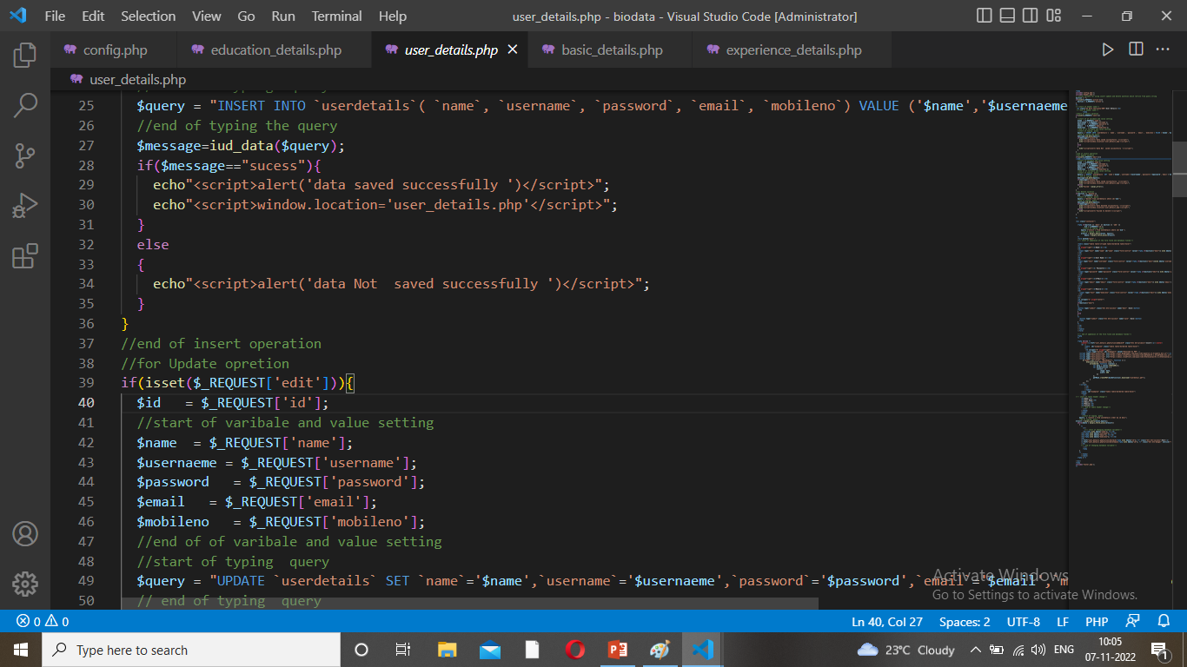
Sample Source code

Slide 35
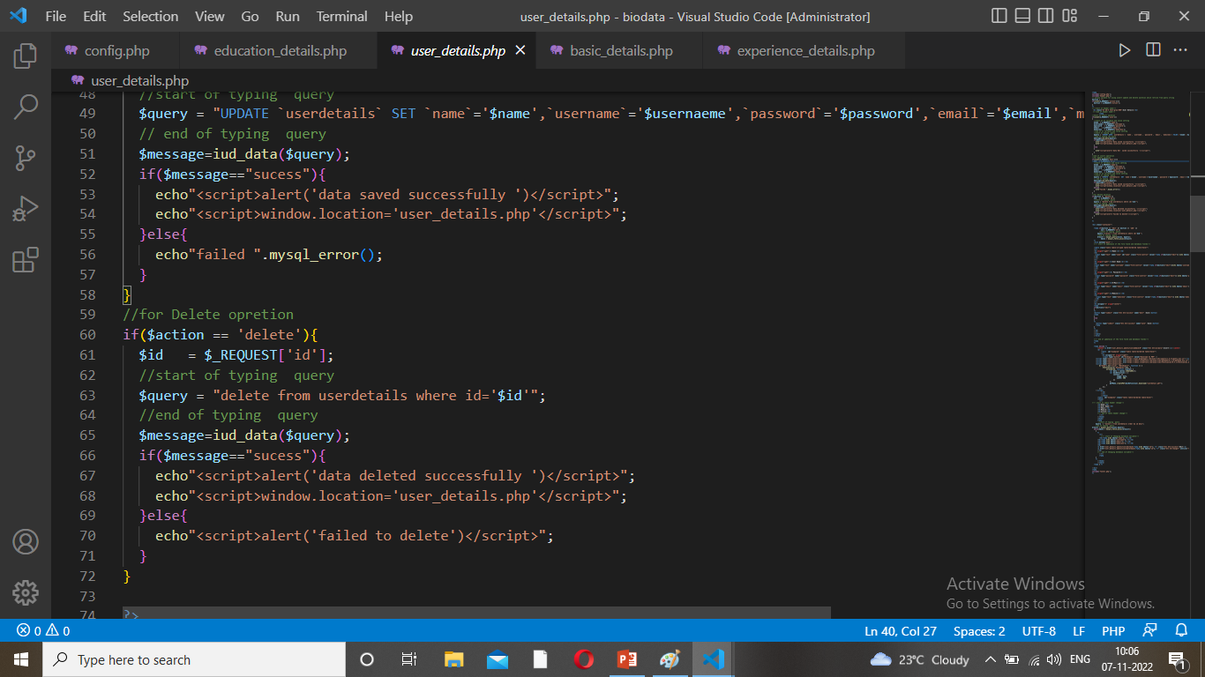
Sample Source code

Slide 36
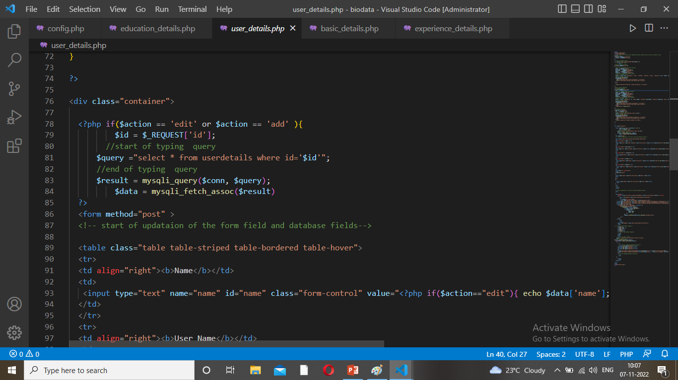
Sample Source code

Slide 37
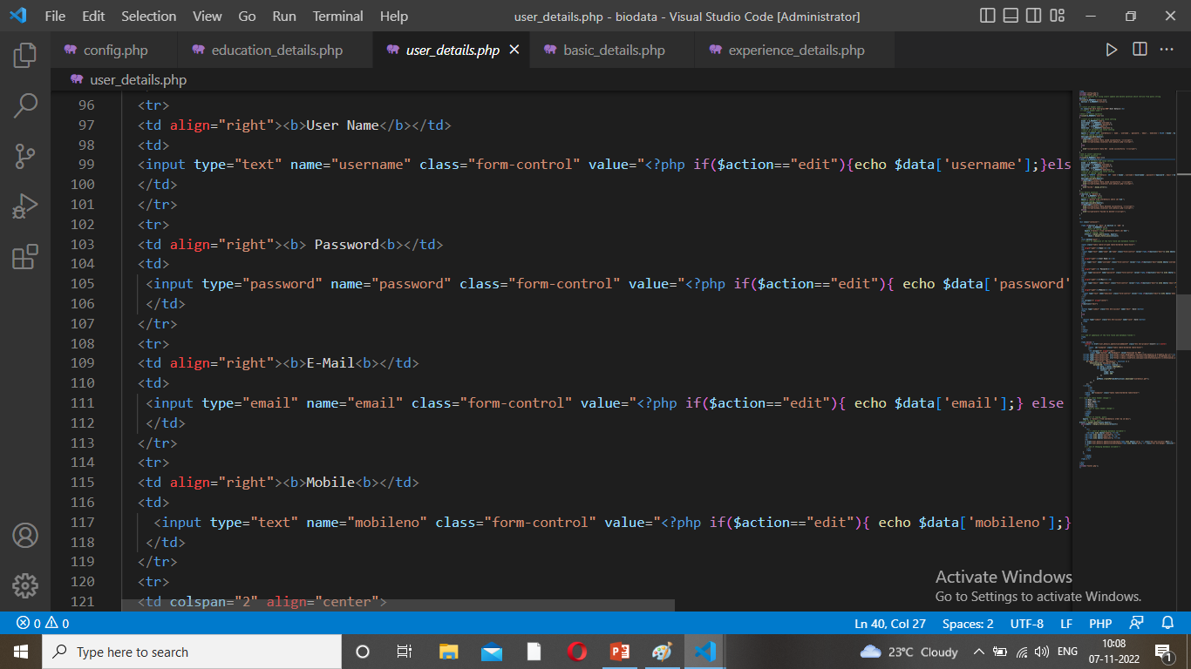
Sample Source code

Slide 38
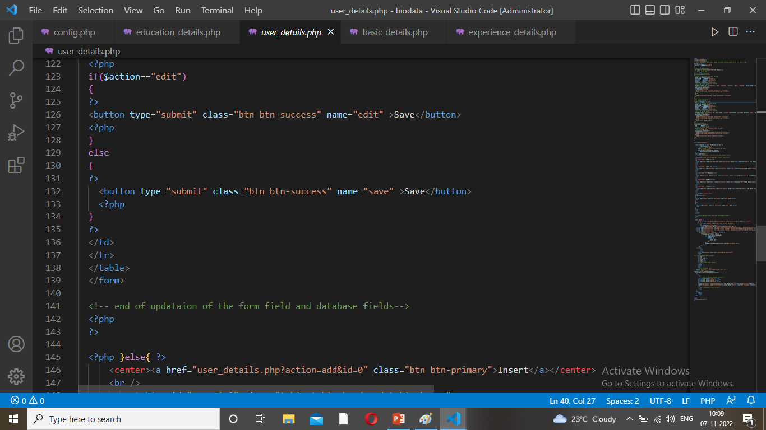
Sample Source code

Slide 39
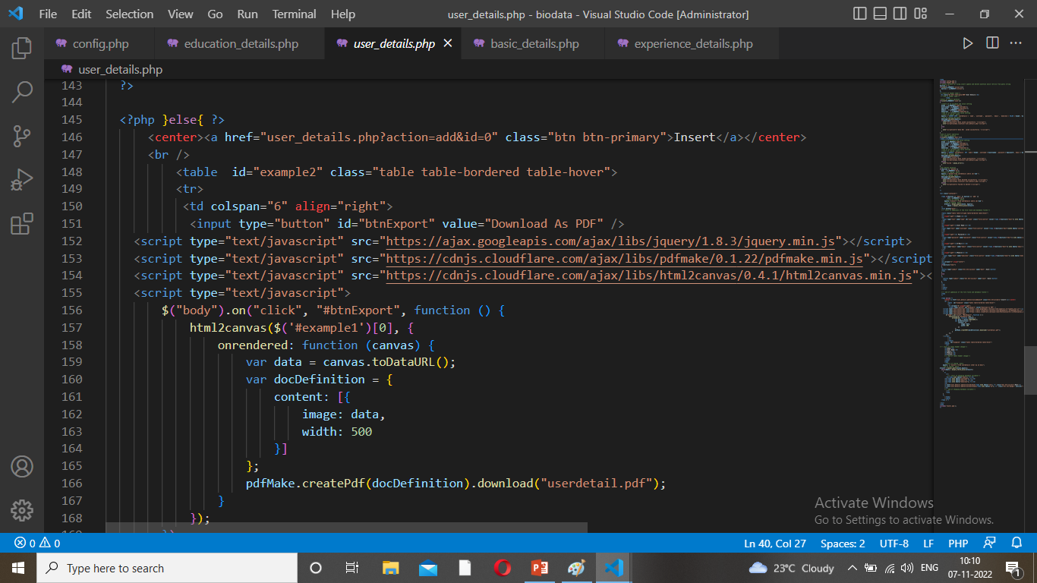
Sample Source code

Slide 40
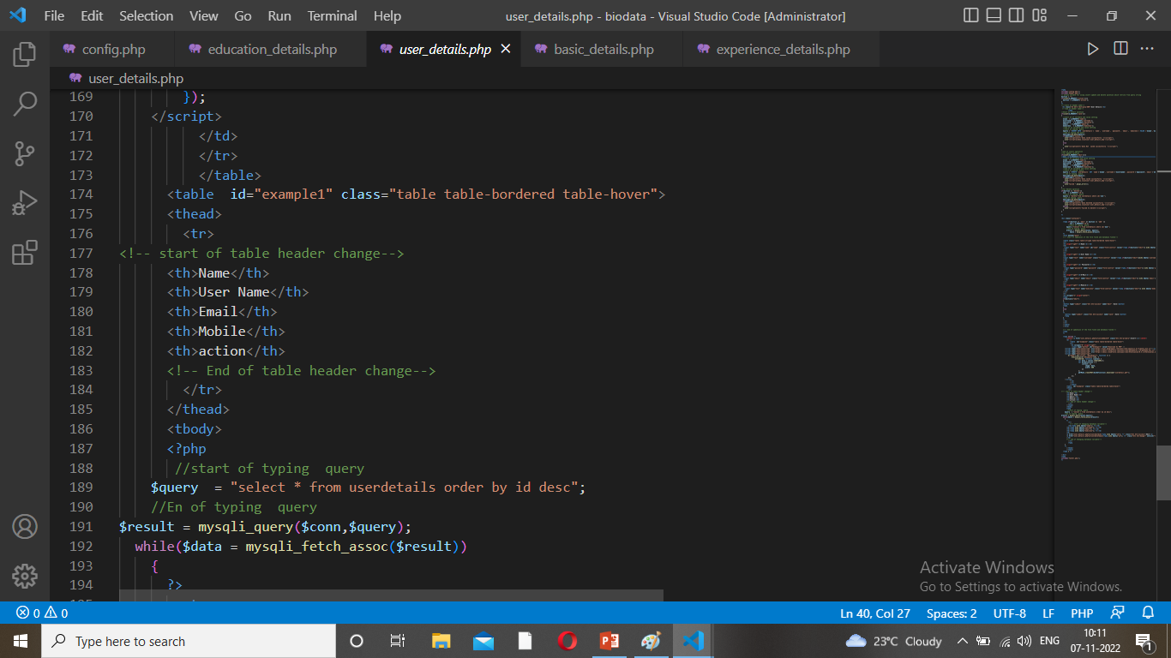
Sample Source code

Slide 41
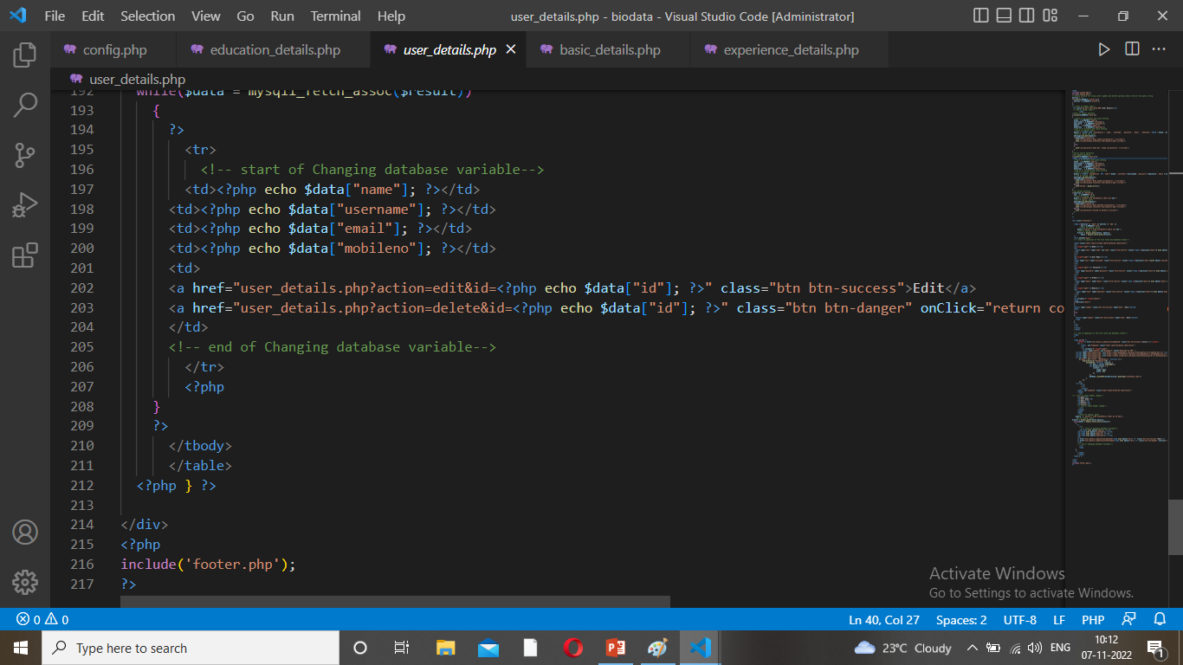
Sample Source code

Slide 42
Problem/difficulty Faced
Primary key not assign.
Not visuable and correct data saved.

Slide 43
Solution to the problem
The data base … check the primary Key … index box also ticked
Check the codings – change the some other coding copy paste and editing mistake – correct the my team support.

Slide 44
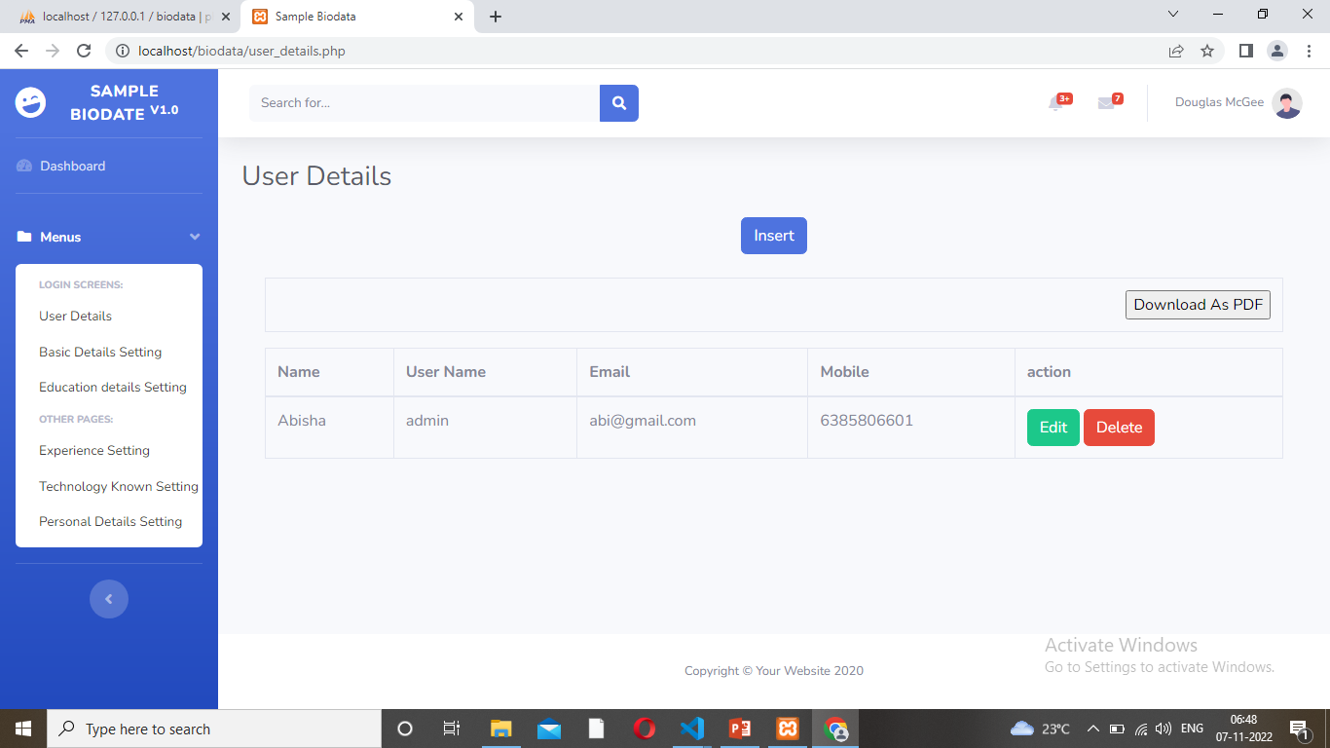
Form Design
1. Click On the insert Button
Notes:
Get the form design from the phpmyadmin or from SRS document

Slide 45
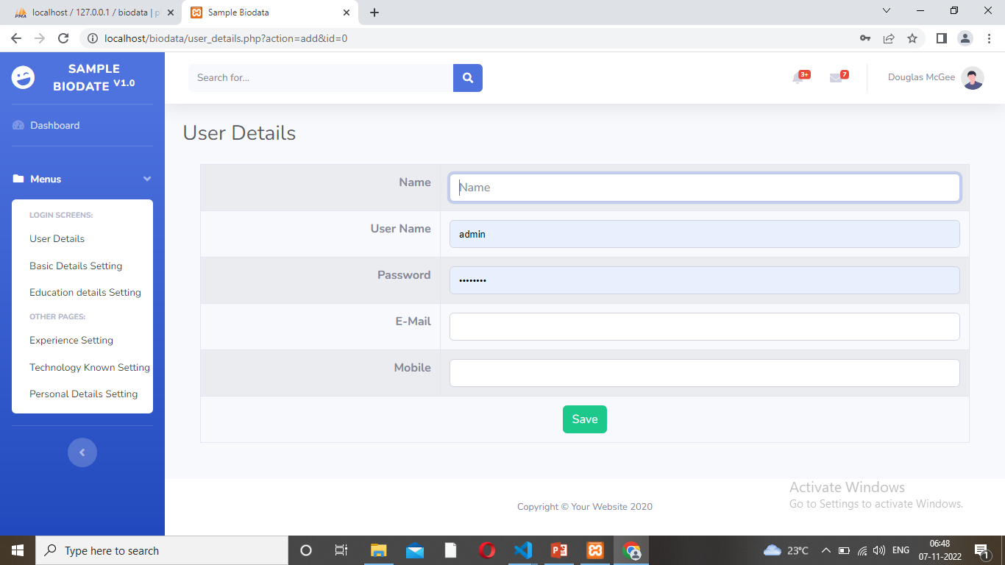
Form Design
2. Open the Form And Type the Details to Save

Slide 46
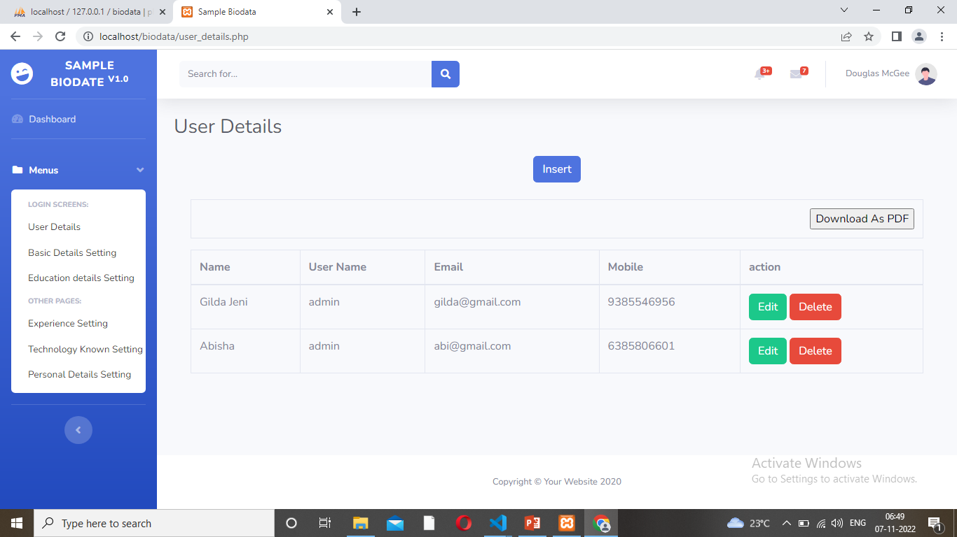
Form Design
3. Save the Details

Slide 47

Form Design
4. Click delete button – deleted on the data

Slide 48
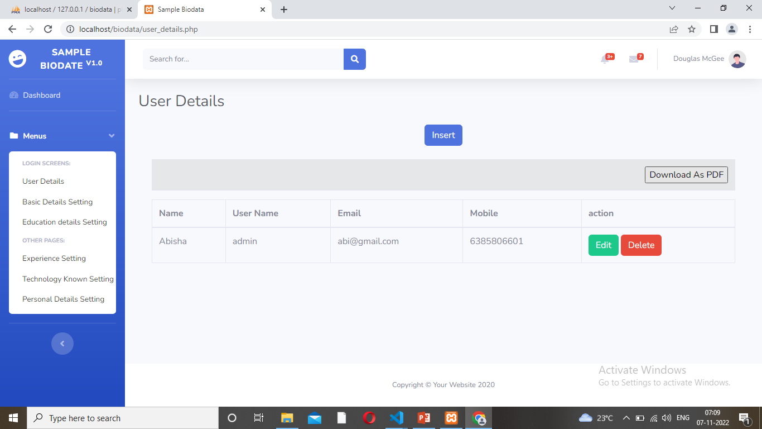
Form Design
5. Click - Download pdf

Slide 49
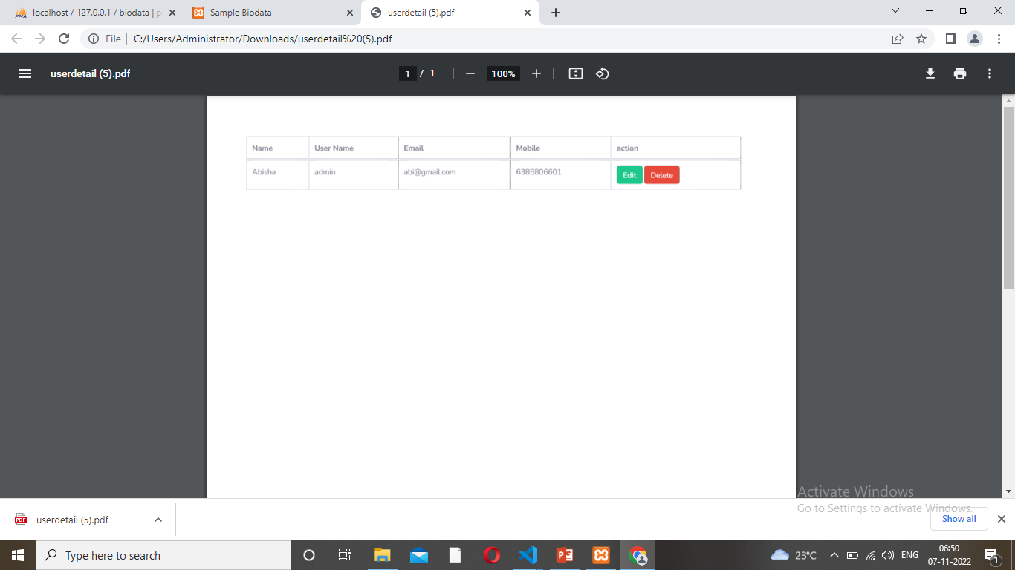
Form Design
6. Print on the document

Slide 50
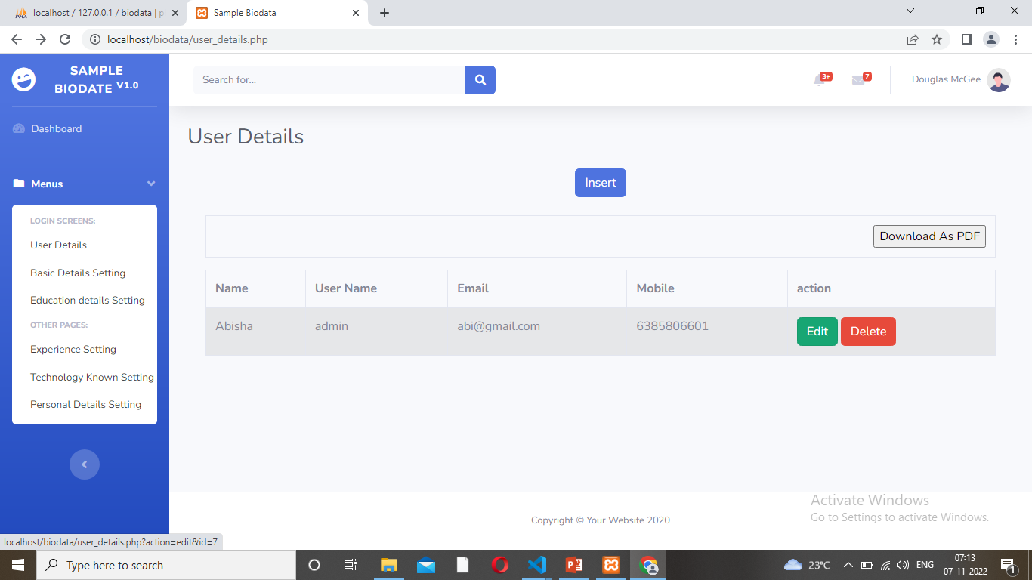
Form Design
7. Click Edit button

Slide 51
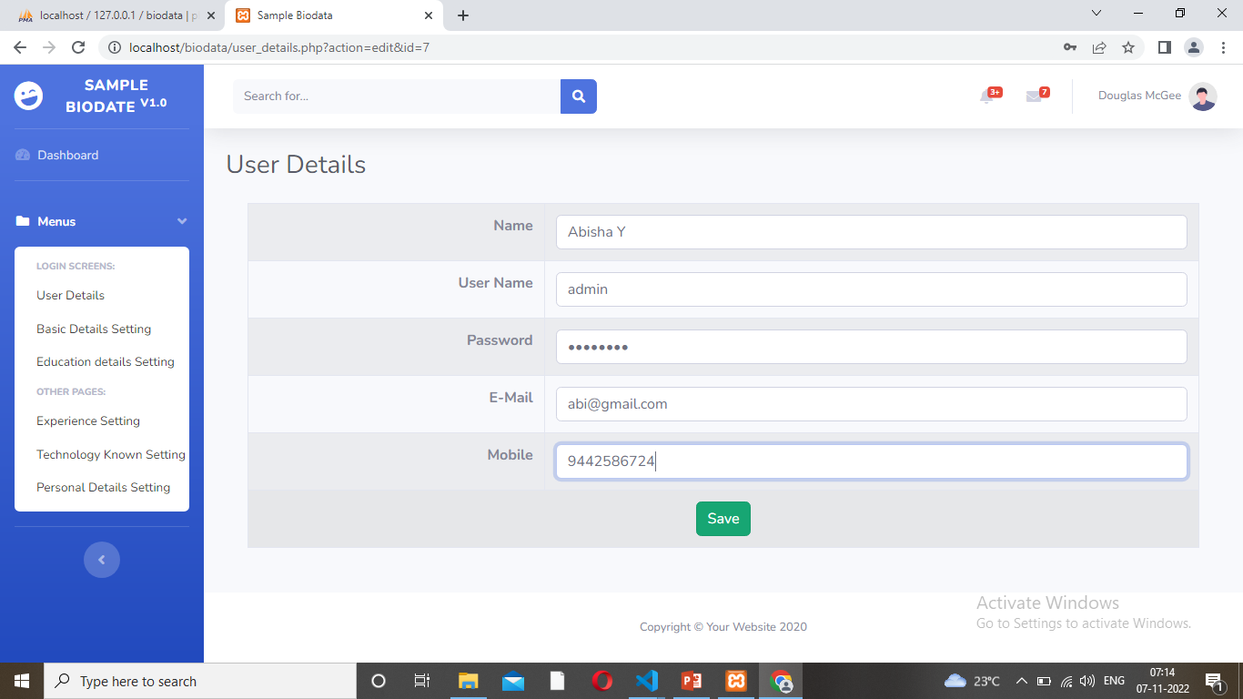
Form Design
8. Edit the form

Slide 52
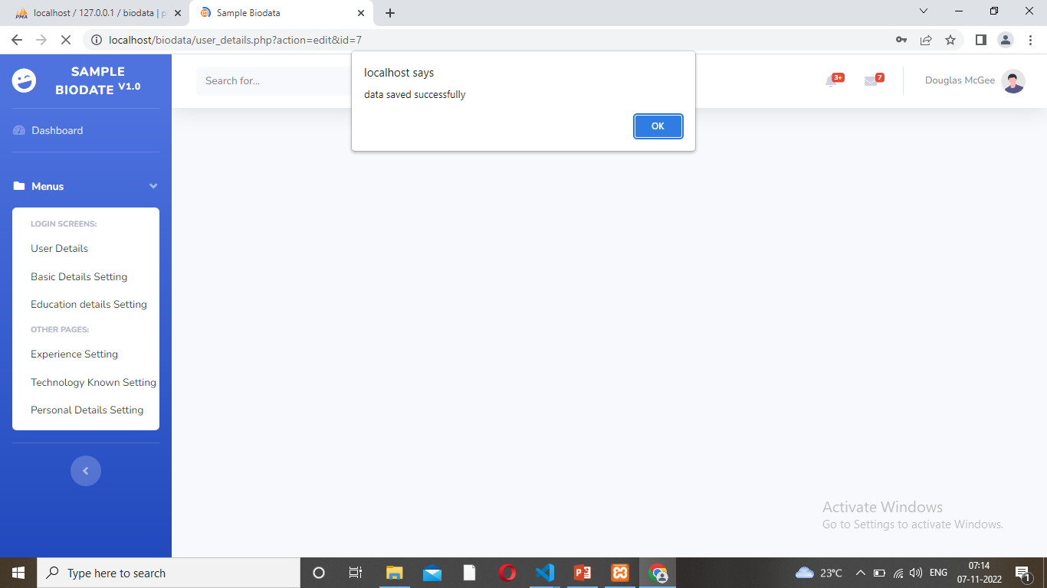
Form Design
9. Saved Data pop message- Click- ok

Slide 53

Form Design
10. Edited details saved on the form

Slide 54
Thank You

